Slide 1

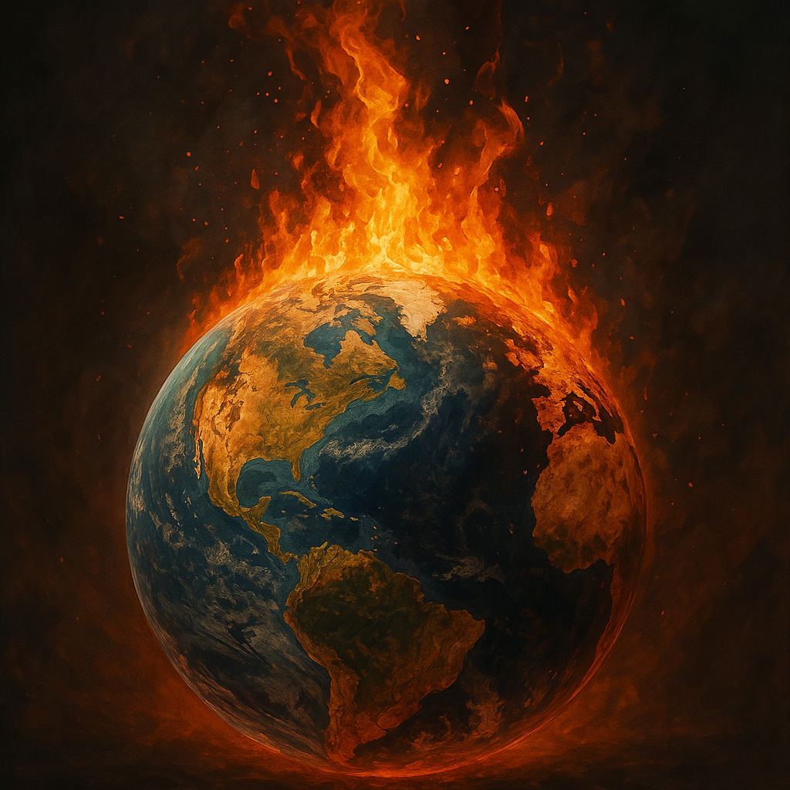
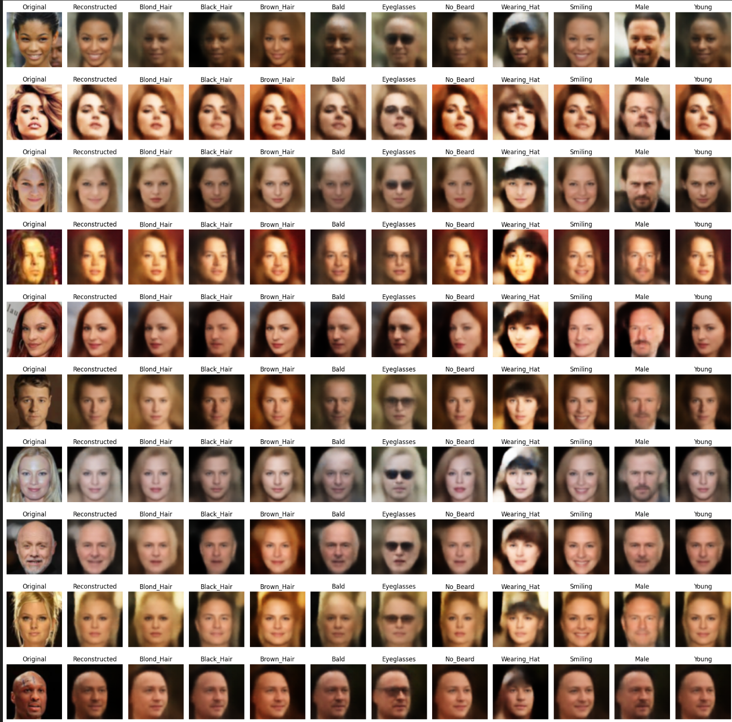
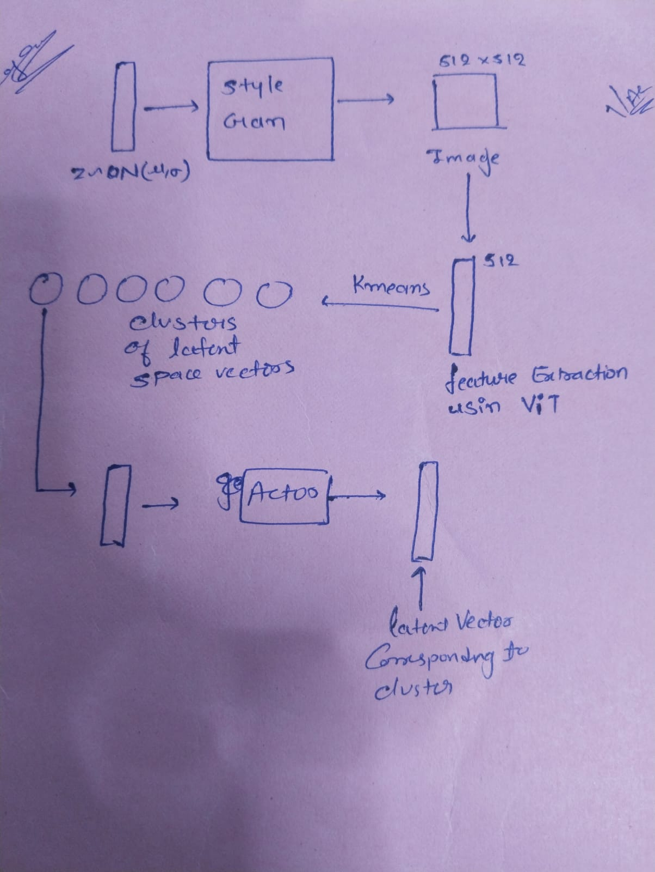
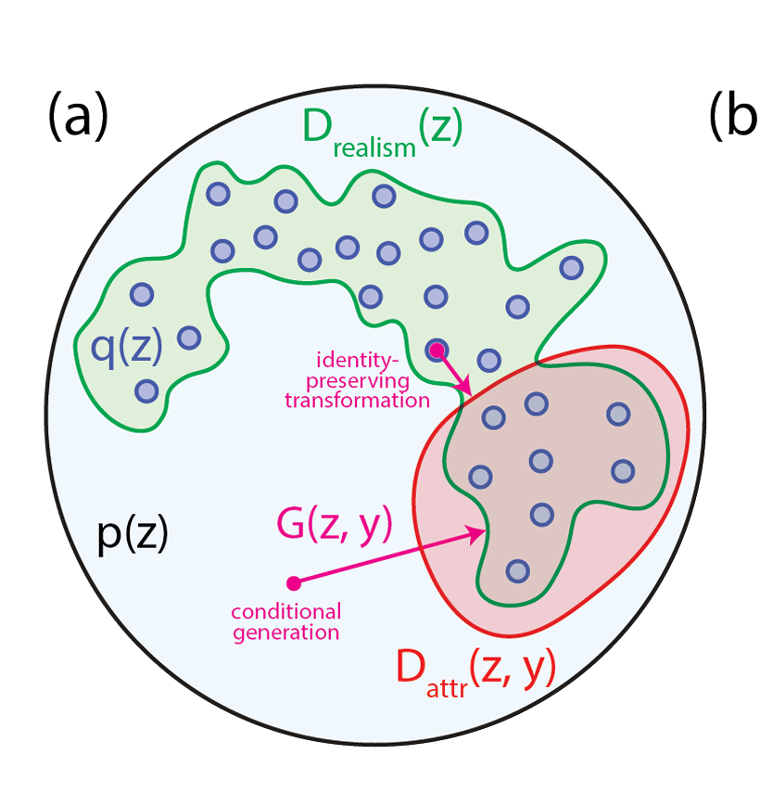
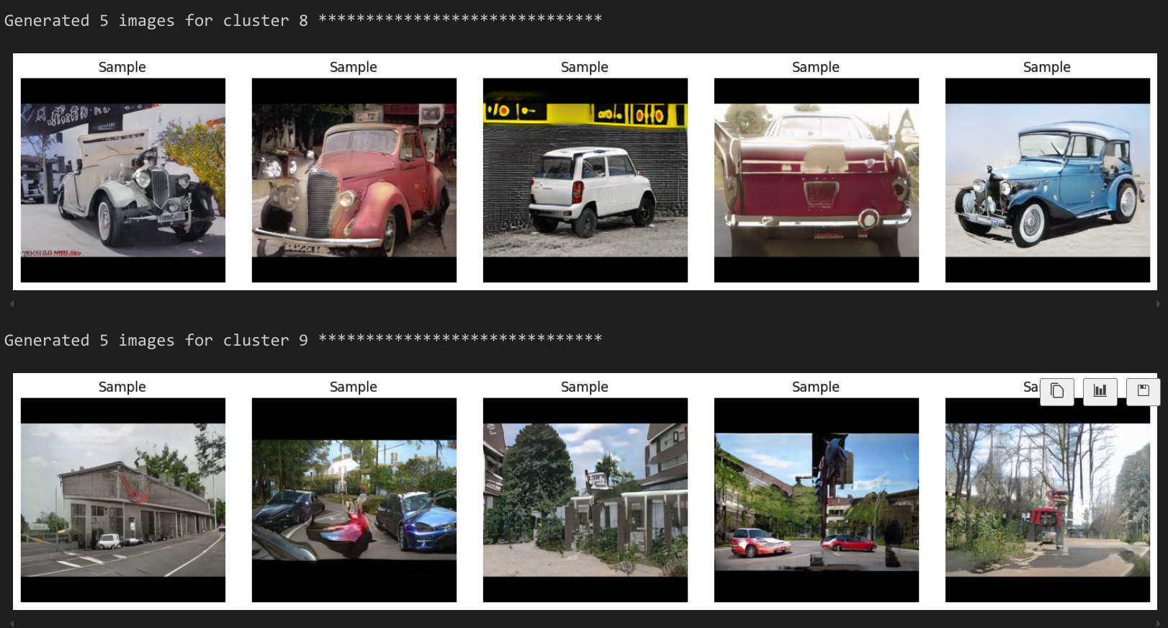
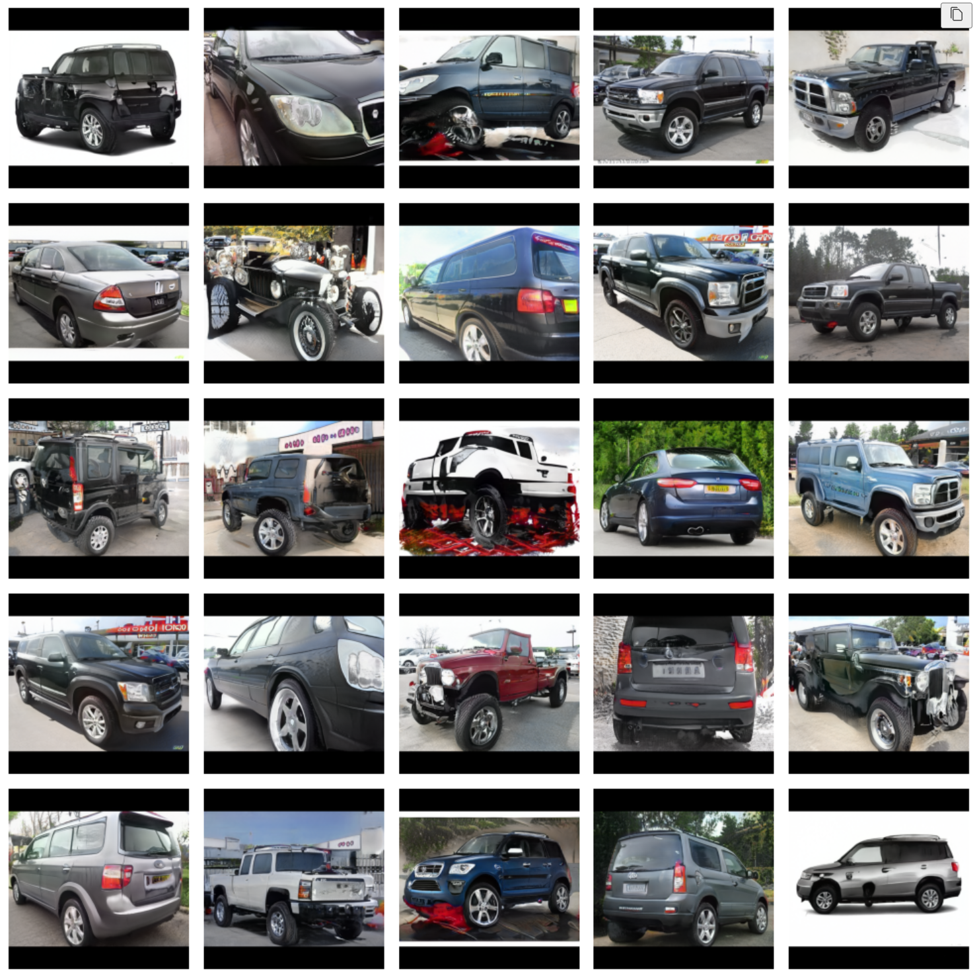
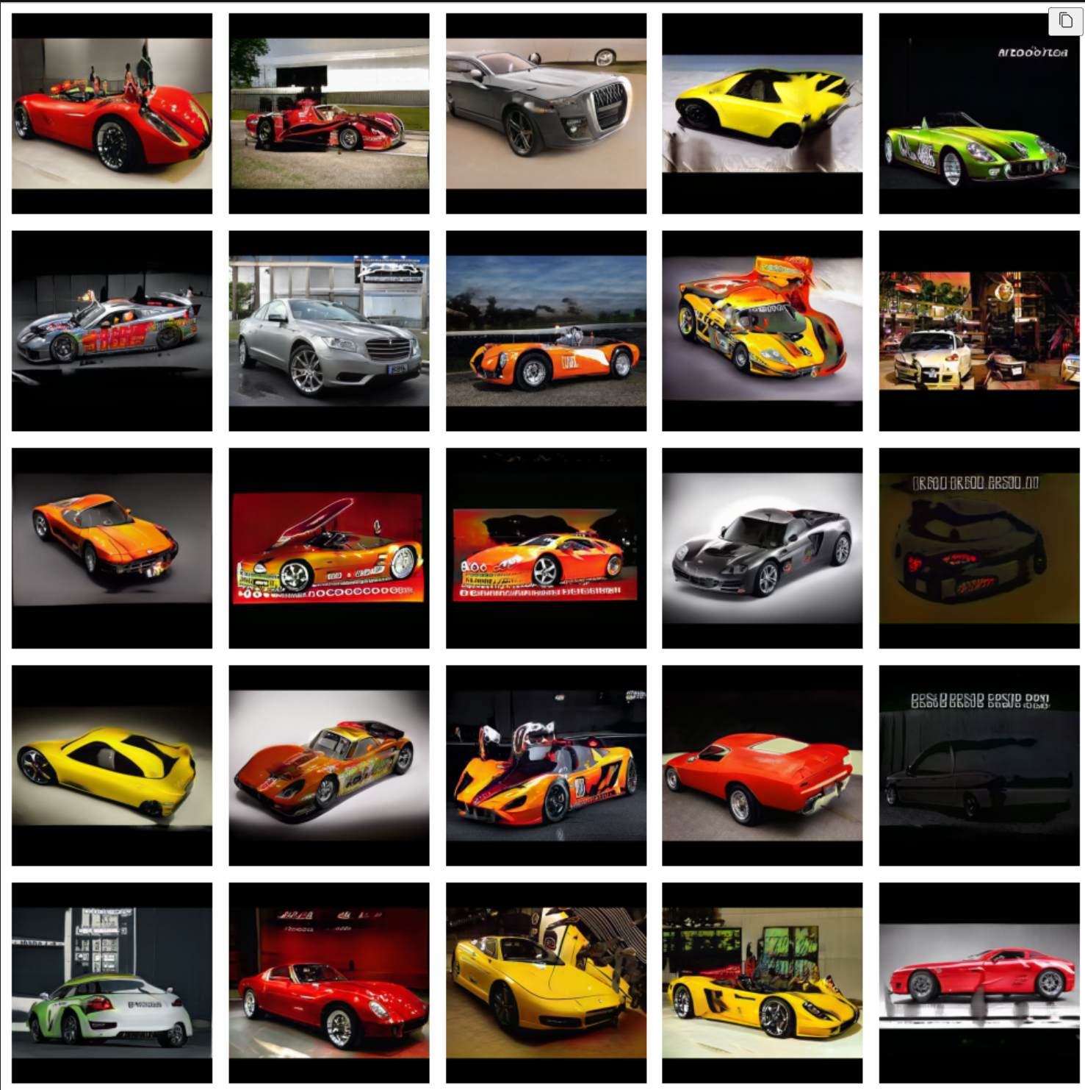
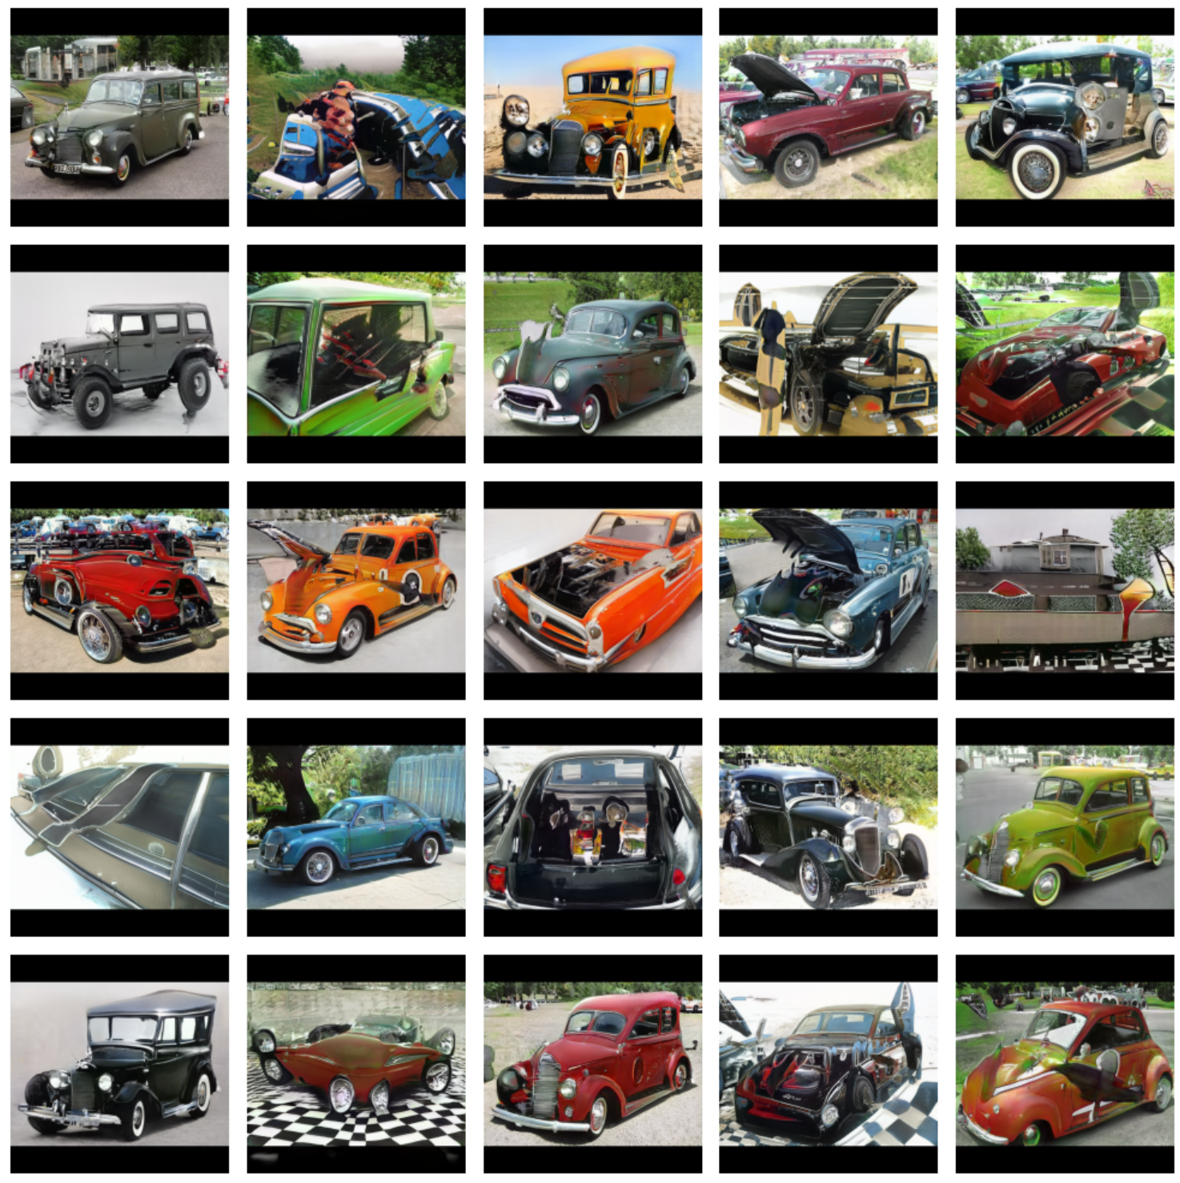


Conditional Generation from Unconditional Generative Models
Haarit Chavda (23110077)
Mentors: Prof.Shanmuganathan Raman , Prajwal Singh
PROBLEM STATEMENT
VAE - CelebA
Save compute and time
Conditional Generation without retraining
Leverage Existing unconditional models
Preservation of identity in transformation
Approach
StyleGan2 - carconfig e
p(z) : Prior Distribution
y : Attributes of data
G(z,y): Actor function
Drealism(z):Realism Constraint
Dattr(z,y): Critiq function
Time taken to train style gan : 72sec/k image
Time taken to generate 50k images : 475 sec
Time taken by ViT for feature Extraction : 25 sec
TIme taken to do Kmean : 216 sec
Latent Gan Training (per cluster) : 220 sec
Total Time : ~ 1000sec
Time taken :20 sec/k image
*For 512 x 512 images using single GPU
Suppose that running the GPU for 10 seconds burns one tree. Using the traditional method would burn 72 trees, but our method would burn only 6 trees.
In our case, only the latent GAN training time increases with the number of clusters; all other times stay the same. For instance, if we used conditional training training with 10 clusters then it would take 720 sec/k images. Our method, however, takes only 52 sec/k images.
Two of the clusters: Vintage Cars and noise images
Deep generative neural networks can create complex data like images in two ways: by simply generating random outputs (unconditional) or by letting you control what gets generated (conditional). Generally, adding new controls requires retraining the model, which can be very costly. In our work, we show a way to add these controls without having to retrain the model. Instead, we learn patterns in the model’s hidden space that mark areas where the generated data has the features we want. Then, we use an actor network to pick points in these areas. By combining rules for specific features with a general rule that makes sure outputs look like real data, we can produce realistic, controlled images from a model that was originally trained without those conditions. We also try to preserve identity while navigating the latent space
Results: SUVs , Sport Cars and Vintage Cars
TIMELINE
APPLICATIONS & FUTURE WORK
Learning GANs, VAEs, NST and Style Gan 2
Replicated the paper : ‘Latent Constraints’ and thoroughly understanding concepts
Applied the learnings on style gan 2 for conditional generation
Applications: There are many unconditional models and using this approach we can directly leverage them without retraining
Limitations : For different architectures and datasets we need to use relevant methods to navigate latent space.
Next Steps in Research
Extend the concept for clip models, LLMs, Energy Models and more …
Build a library that would integrate over any sort of model and provides utility to leverage the latent space
RÉFÉRENCES
Engel J., Google Brain, Hoffman M. D., Google Inc., Roberts, A., & Google Brain. (2017). LATENT CONSTRAINTS: LEARNING TO GENERATE CONDITIONALLY FROM UNCONDITIONAL GENERATIVE MODELS. https://arxiv.org/pdf/1711.05772.
Karras, T., NVIDIA, Laine, S., NVIDIA, Aila, T., & NVIDIA. (n.d.). A Style-Based Generator Architecture for Generative Adversarial Networks. Research Paper. https://openaccess.thecvf.com/content_CVPR_2019/papers/Karras_A_Style-Based_Generator_Architecture_for_Generative_Adversarial_Networks_CVPR_2019_paper.pdf
NVlabs.(n.d.).GitHub-NVlabs/stylegan2-ada-pytorch: StyleGAN2-ADA-Official PyTorch implementation.GitHub. https://github.com/NVlabs/stylegan2-ada-pytorch
Notes:
Size of the vehicles (y_axis) & number of wheels in the x-axis
Literature review hands on working on GAN working
experiments for real world images
applications of these Draggan
limitations of draggan applications of this research work
aur kidhar kaam me aayega in chemical and chemistry department Humne hamare kya inputs diye………
existing networks pe train karke kaafi saare experiments kiye hands on GAN implementations literature review as draggan had limitations and freedrag (2024 cvpr accepted) solved them
will study freedrag (will it work on few-shot images K-way N-shot learning (K-classes and N - number of images)) - focus on improving this
future scope: - currently we are able to do manipulations on their own in-domain synthetic images on which the model is pre-trained on, and we have also tried to put our own local image, but the modifications didnt show up because the image was out of distribution for the model and we need to do fine tuning on our own few-shot data such that the modifications also reflect in our custom data also

